Slide 1


Slide 2


Slide 3
Core Competency
Understand effective strategies for increasing staff support for breastfeeding and improving breastfeeding competencies.

Slide 4

Learning Objectives
Explain the “Grow and Glow” concept in building staff competencies in breastfeeding promotion and support.
Identify four principles of adult learning that should be incorporated into training.

Slide 5
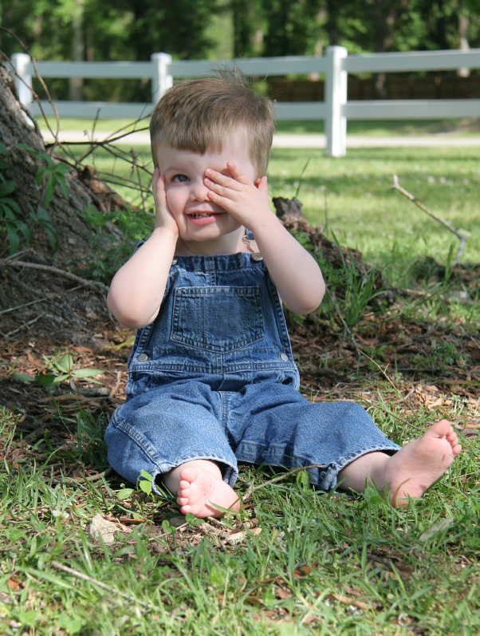
Let’s Get to Work!
“Opportunity is missed by most people because it is dressed in overalls and looks like work.”
--Thomas Edison

Slide 6
Breastfeeding Training for WIC Staff
WIC’s mission is to improve health of nutritionally at-risk women, infants, and children
Staff training required
Orientation for new staff
Ongoing training for all staff

Slide 7


Slide 8
About the Theme
Grow
Babies grow with good health
Mothers grow confidence
Staff grow in their ability to educate and support breastfeeding families
Glow
Helping mothers breastfeed so their babies can glow with good health
Helping mothers glow with pride
Power of staff recognition

Slide 9
Who Should Train WIC Staff
Lactation management experts
WIC agency breastfeeding coordinator
WIC peer counselor coordinator
Community resources
WIC supervisors and program coordinators

Slide 10
Training Overview

Slide 11
Training Modules
Module 1 – How WIC Supports Breastfeeding
Module 2 – Feelings About Breastfeeding
Module 3 – Communicating With Breastfeeding Families
Module 4 – Barriers to Breastfeeding
Module 5 – Promoting and Encouraging Exclusive Breastfeeding

Slide 12
Training Modules
Module 6 – Promoting Breastfeeding During Pregnancy
Module 7 – Providing Support for New Breastfeeding Moms (Birth to 1 Month)
Module 8 – Helping Mothers Continue the Breastfeeding Relationship (1 Month to 12 Months)
Module 9 – Talking With Mothers About Breastfeeding…When Mother and Baby Are Separated
Module 10 – Solutions for Common Breastfeeding Problems

Slide 13


Format of the Modules
Module Contents
Instructional Icons
Core competencies
Learning objectives
Module overview
Speaker notes
Talking Points
Instructional Guidance
Activity Instructions
Handouts
Activity
Instructional Guidance
Local Info

Slide 14

Other Training Tools
“My Goals for Breastfeeding Support”
Goal-Setting Flower

Slide 15

Training Resources Provided
DVD: “Show Me Video Vignettes”
DVD: “To Baby With Love: Overcoming Breastfeeding Barriers” (Texas WIC State Agency)
DVD: “Breastfeeding: Another Way of Saying I Love You” (Mississippi WIC State Agency)
Book: “Quick Reference for the Lactation Professional”

Slide 16
Curriculum Terms Used

Slide 17
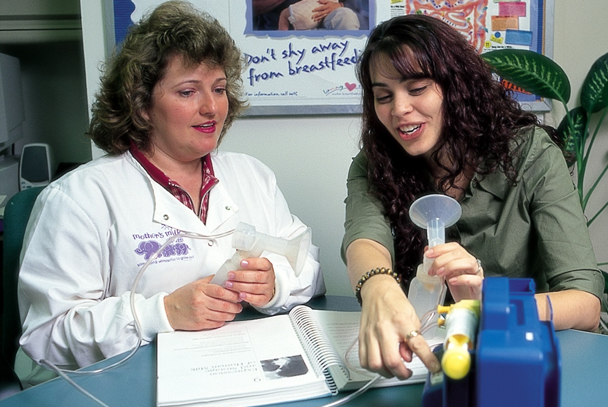
The WIC Designated Breastfeeding Expert

Slide 18
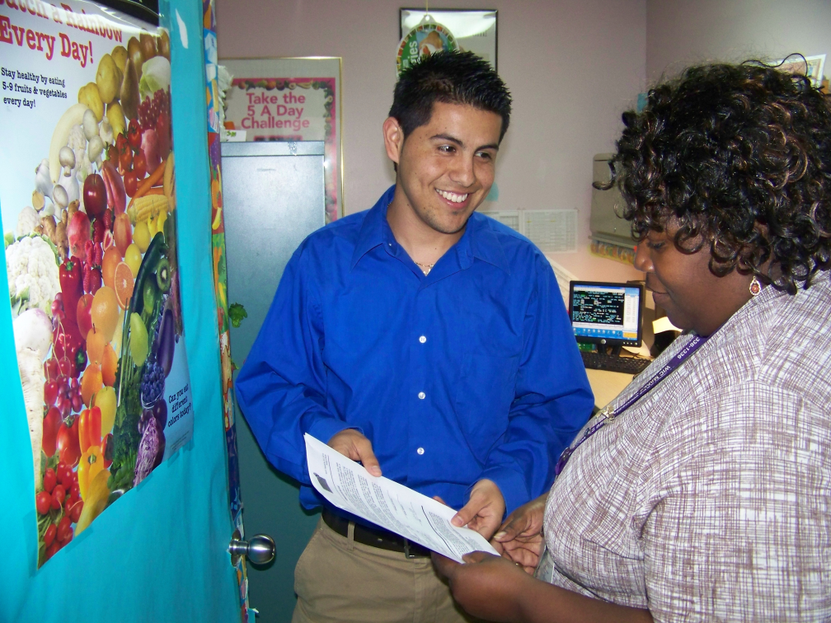
Yield
WIC Designated Breastfeeding Expert
Nutritionist
Peer counselor
Clerical staff
Medical professionals
Other resources in the community
North Miami WIC

Slide 19
Effective Training Approaches
Auditory Learners | Visual Learners | Kinesthetic Learners
Stories | Video | Group activities
Lecture | Slides and flip charts | Physical touch
Group discussion | Engaging photo images | Role playing
Informal conversations | Demonstrations | Application practice
Music | Drama | Taking notes

Slide 20
Use Adult Learning Techniques
Active involvement in learning new skills
Reinforcement
Repetition
Visual aids
Recognition

Slide 21
Keep the Pace Moving
Adult attention span
Learning techniques:
Change types of activities

Slide 22
Make Your Point as Visual as Possible
Learning techniques:
Slides with lots of engaging photo images
Flip charts to record ideas and thoughts
Examples and demonstrations
Drama
Video

Slide 23
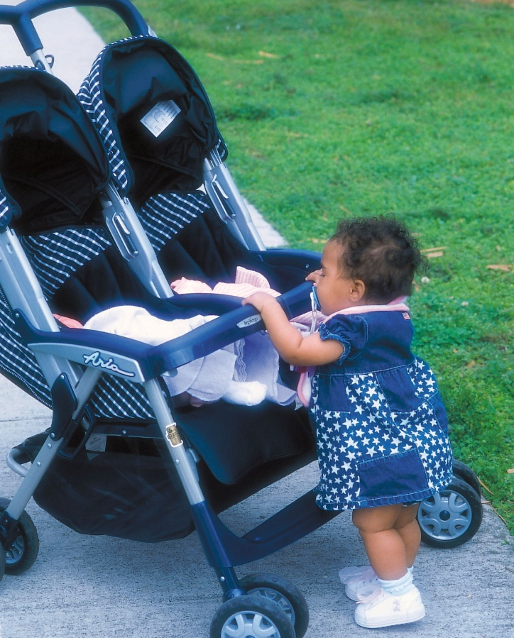
Teach Small Amounts
Focus on the core information
Keep language and messages simple

Slide 24
Repeat the Information
Learning techniques:
Role plays
Written handouts, other materials
Discussion

Slide 25
Keep It Relevant
Learning techniques:
Facilitated discussion
Storytelling
Practice opportunities
Goal setting
Structured ongoing enrichment

Slide 26
Foster Skills-Building Opportunities
Learning techniques:
Role play
Practice scenarios and situations
Task-oriented group activities

Slide 27
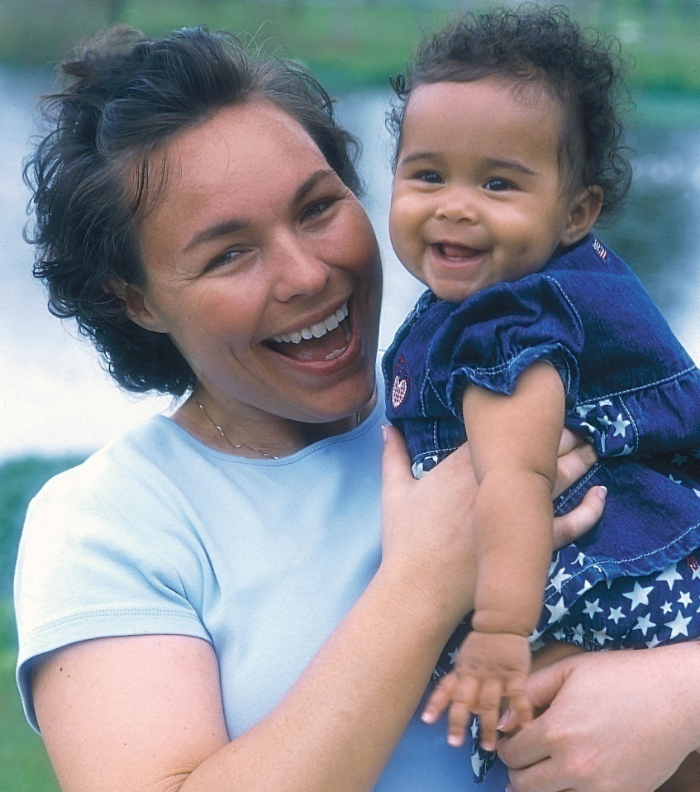
Reward Participants When Learning Occurs
Learning techniques
Public and private affirmation
Physical rewards

Slide 28
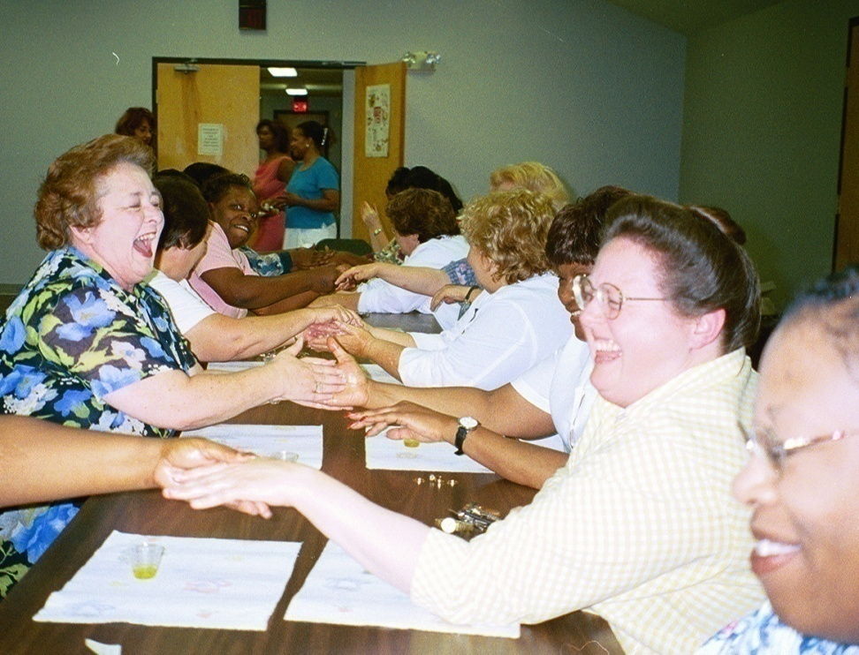
Above All: Make It Fun!
Welcoming environment
Room setup
Reinforce the theme
Door prizes
Themed centerpieces at tables
Washington County, Mississippi WIC

Slide 29
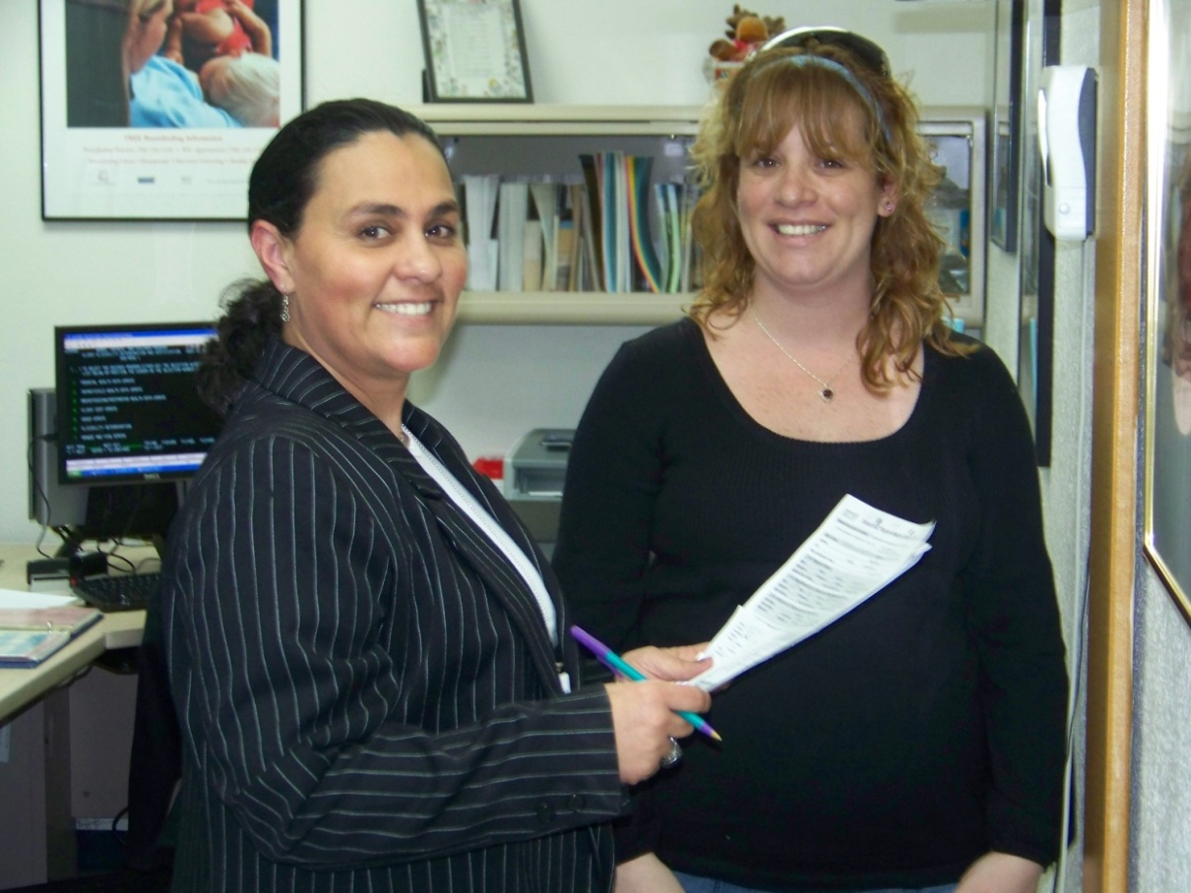
Help Staff Glow With Breastfeeding Support
Hialeah West WIC, Miami, FL

Slide 30

Technical Assistance for Trainers
Conference call after training event
Ongoing technical assistance by phone, email
Access to training materials and resources on WIC Works Resource System at
http://www.nal.usda.gov/wicworks/Learning_Center/BF_training.html

